Slide 1
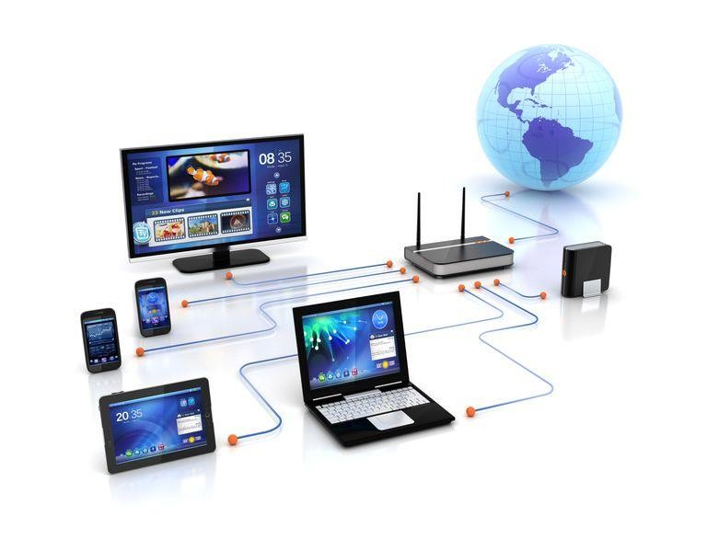
Computer Hardware
Introduction to Computer Science
Lecturer : Thilina Soysa
1

Slide 2
Module Objectives
Explain the different number systems and how data is represented within the computer system
Select the appropriate computer components to build, repair, or upgrade personal computers
Explain how to correctly use tools and safely work in a lab
Explain Software and how it executes on software
Explain the concept of network communications
Configure devices to connect to the Internet
Explain basic concepts and use of Multimedia
Apply the logic for computer programs
3

Slide 3
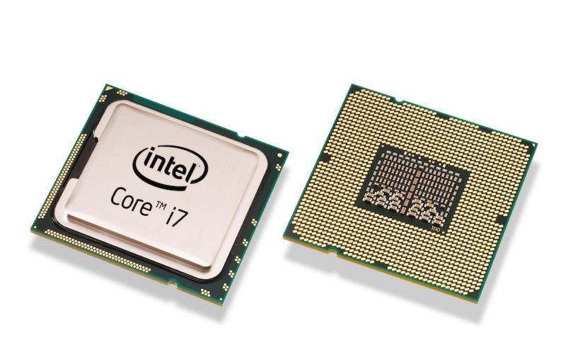
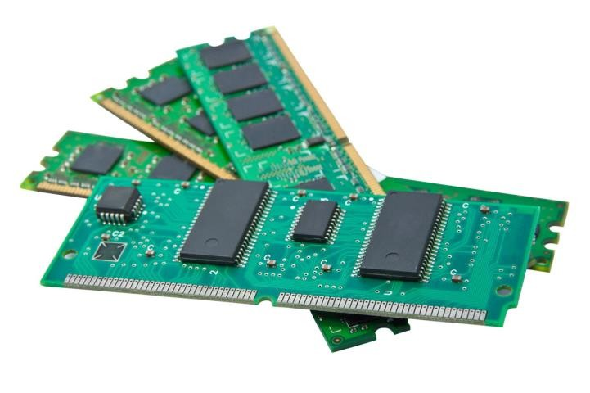
Introduction
Computer System consists of three parts;
  Hardware
  Software
  Live ware (Users)
Computer Hardware can be broken down into three main parts:
  CPU
  Memory
  I/O

Slide 4
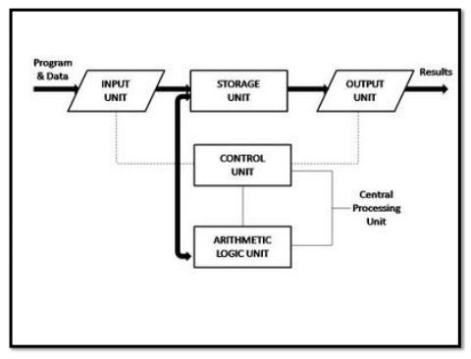
Computer Basic Operations

Slide 5
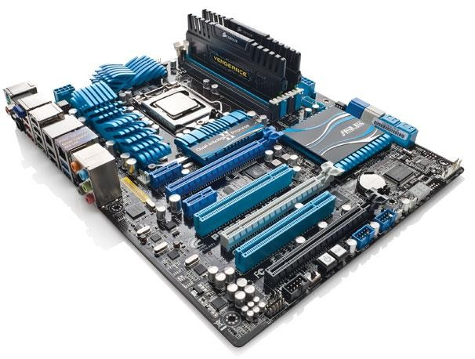

Internal PC Components
Motherboards
  Backbone of the computer
  Interconnects computer components
CPU
  The brain of the computer
  Most processing is done by the CPU
Cooling Systems
  Dissipates the heat generated by computer components.
Memory (ROM and RAM)
  RAM: Stores data temporarily, aiding processing
  ROM: Stores data permanently; often storing firmware
and low level programs

Slide 6
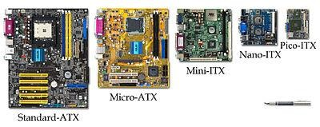
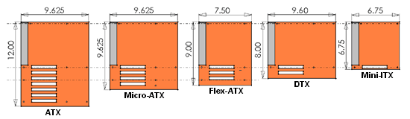
Motherboard Form Factors
The form factor of motherboards pertains to the size and shape of the board.
It also describes the physical layout of the different components and devices on the motherboard.
Various form factors exist for motherboards.
  AT – Advanced Technology
  ATX – Advanced Technology Extended
  Mini-ATX – Smaller footprint of ATX
  Micro-ATX – Smaller footprint of ATX
  LPX – Low-profile Extended
  NLX – New Low-Profile Extended
  BLX – Balance technology Extended

Slide 7
RAM Types
SDRAM (Synchronous Dynamic Random-Access Memory):
This enables the memory controller to know the exact clock cycle when the requested data will be ready, so the CPU no longer must wait between memory accesses. SDRAM must wait for the completion of the previous command to be able to do another read/write operation.
DDR SDRAM (Double Data Rate SDRAM):
Doubles the transfer rate without increasing the frequency of the clock. The transfer rate of DDR is between 266~400 MT/s. DDR266 and DDR400 are of this type.
DDR2 SDRAM(Double Data Rate Two SDRAM):
Its primary benefit is the ability to operate the external data bus twice as fast as DDR SDRAM. This is achieved by improved bus signal. The transfer rate of DDR2 can reach 533~800 MT/s with the improved I/O bus signal. DDR2 533 and DDR2 800 memory types are on the market.
DDR3 SDRAM(Double Data Rate Three SDRAM):
DDR3 memory reduces 40% power consumption compared to current DDR2 modules, allowing for lower operating currents and voltages (1.5 V, compared to DDR2's 1.8 V or DDR's 2.5 V). The transfer rate of DDR3 is 800~1600 MT/s.
DDR4 SDRAM (Double Data Rate Fourth SDRAM):
DDR4 SDRAM provides the lower operating voltage (1.2V) and higher transfer rate. The transfer rate of DDR4 is 2133~3200 MT/s. DDR4 can process 4 data within a clock cycle.

Slide 8
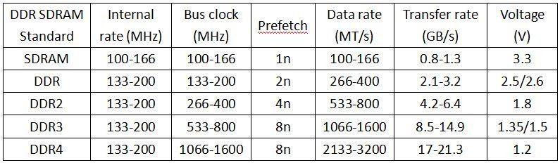
RAM Types

Slide 9
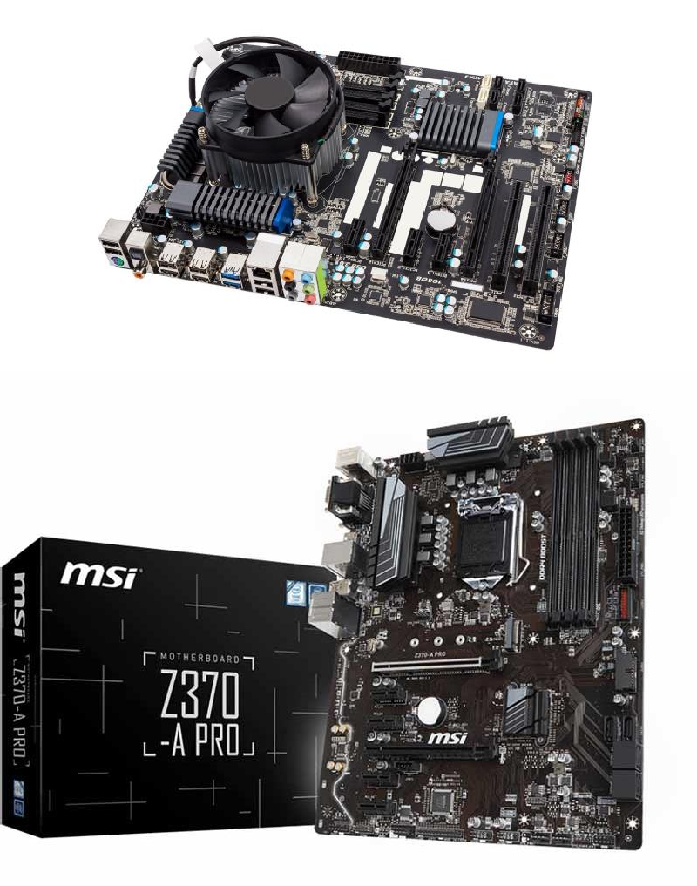
Internal PC Components (Cont.)
Storage Devices
  Designed to permanently store user data, user applications and the Operating System
  Can be internal or external to the computer
Adapter Cards and Expansion Slots
  Adapter Cards extend computer functionality
  Adapter Cards connect to the motherboard through Expansion Slots
Video Ports
  Connects a video system to an external display device such as a monitor or projector
  Video systems are often designed as an adapter card.
General Ports
  Provide connectivity between the motherboard and various external devices such as printers, external storage and video cameras.

Slide 10
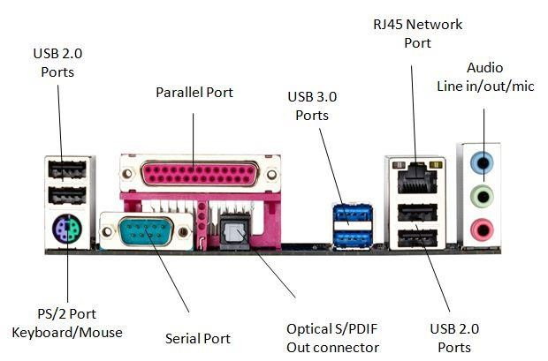
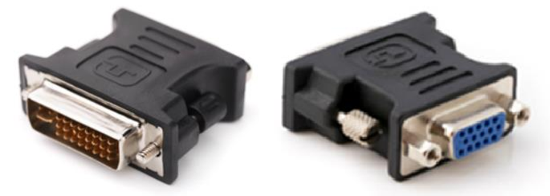
External Ports and Cables
Video Ports and Related Cables
  A few different standards govern video traffic between the computer and external video devices.
  HDMI and DisplayPort are examples of video ports that
require a specific cable to operate.
Other Ports and Related Cables
  Motherboards have a number of other ports used for device connectivity; USB is a common example.
Adapters
  Adapters can be a solution if a motherboard does not have the proper port to connect to a device.
  Adapters do not usually process the signal; they simply
redirect it to another pin.

Slide 11
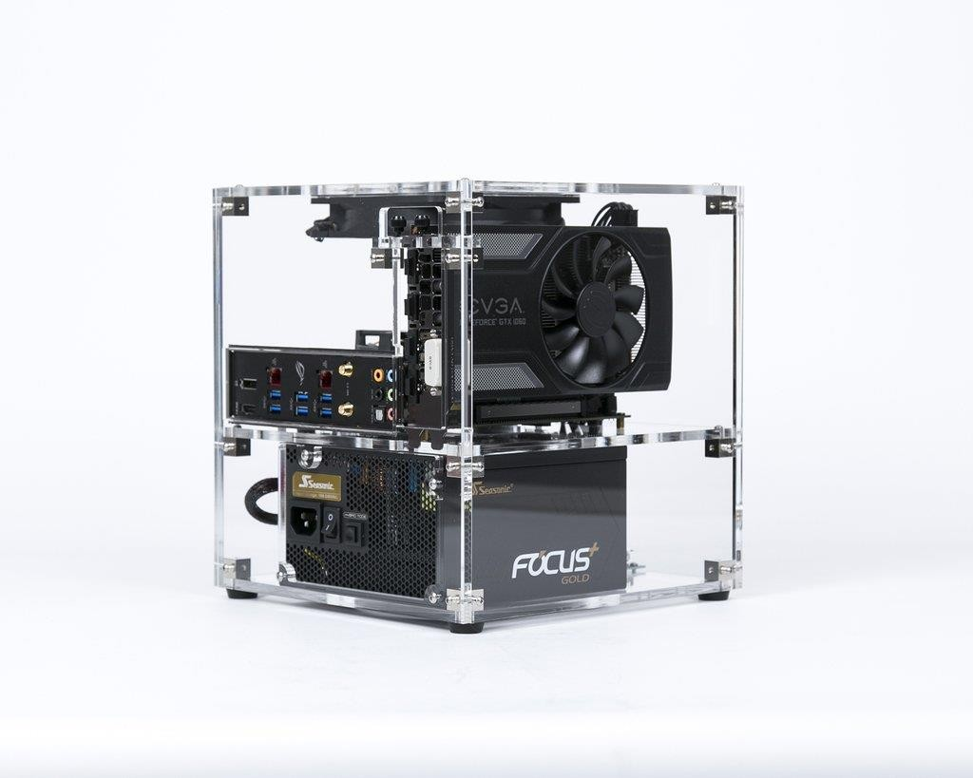
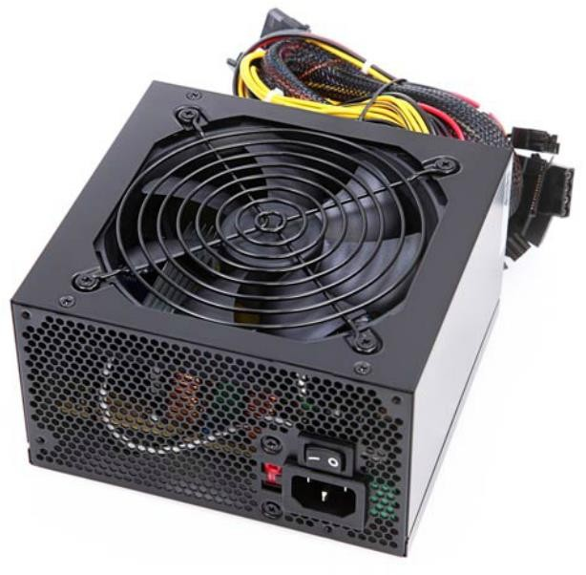
Cases and Power Supplies
Cases
  Size and Layout is called “Form Factor”
  Influences the motherboard form factor choice
  Must allow for good air flow
  Available in different sizes
Power Supplies
  Provides power to all computer components.
  Must be chosen based on current and future needs.
  Deliver different voltage levels to meet different internal component needs.
Power Supply Wattage
  P = V x A

Slide 12
Best Practices
Impact of each device in the overall computer power consumption.
Below are some common computer components and their average power consumption:
Motherboard | 35W (low end) | 75W (high end)
CPU | 77W (low end) | 120W (top end)
Memory | 3W (low end) | 4.5W (high end) *
Video Card(s) | 70W(low end) | 470W(top end)**
SSD Drive 3.5 HDD Drive SATA Blu-ray Drive | 1.5W 7.5W 30W
SATA DVD Drive 80 mm Case Fan (2,000 RPM) | 20W 1.5W
A few devices still not accounted for are: USB drives without power supply, adapter cards, extra fans, etc.
(*) DDR3 memory operates with lower voltages; lower voltages lead to lower power consumption.
(**) under heavy operation.

Slide 13

Best Practices
The website hosted on the URL shown below has a power calculator. It could be helpful to allow students to get a better grasp on the power consumption requirements of computer components.
http://outervision.com/power-supply-calculator

Slide 14
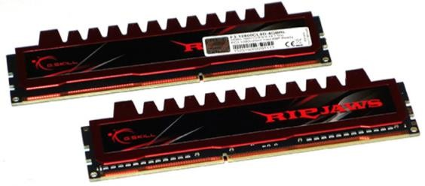
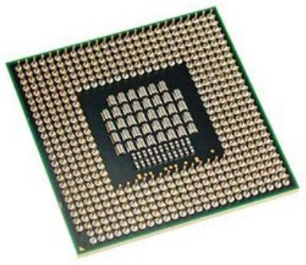
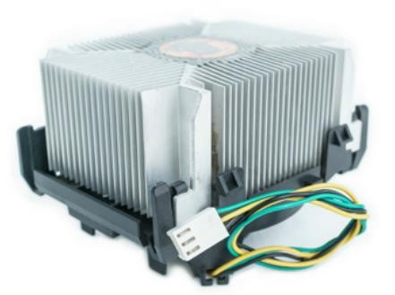
Select PC Components
Select the Motherboard, CPU, Case and Memory
  CPU, memory, motherboard and case choices are inter-related.
  The motherboard should support all customer required applications and still fit properly in the case.
  The case should host the motherboard, the proper power supply and provide good airflow for the internal components.
  The CPU must be compatible with motherboard CPU slot and voltage; it should be compatible with the chosen memory speed for maximum performance.
  The memory must also be compatible with motherboard
memory slots and voltage.
  The amount of memory will depend on the type of applications requested by the customer.

Slide 15
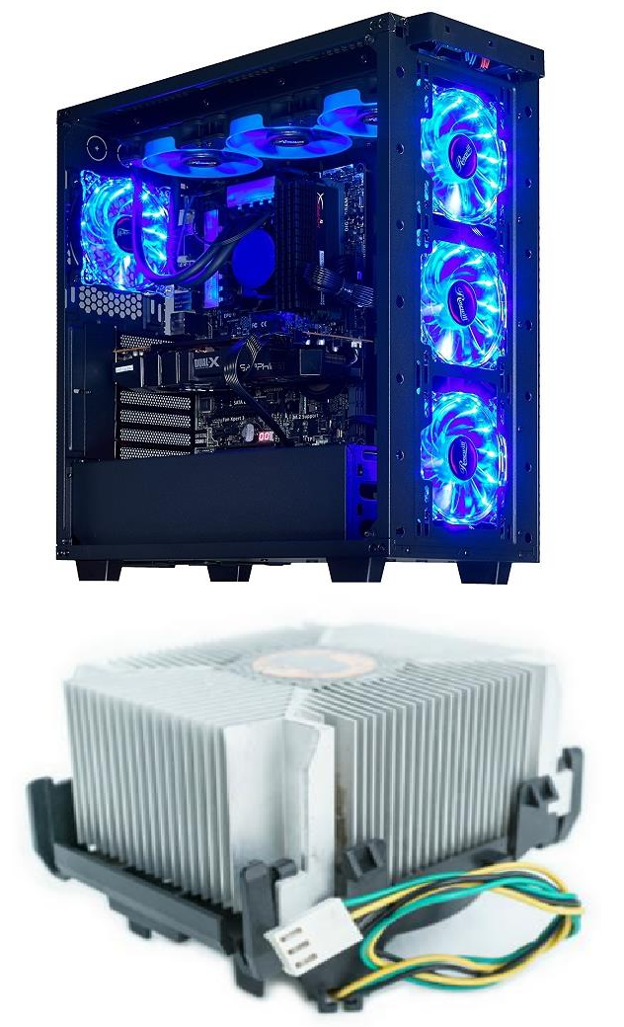
Select PC Components (Cont.)
Select the Case and Fans
  Case and fans must be chosen to maximize internal airflow.
  The fans must fit the case and be within the power limits provided by the power supply.
Select the Power Supply
  The power supply should be selected based on the maximum
amount of power required by all the internal components.
  Remember that some components will draw more power while under heavy load.
Select Adapter Cards
  Make sure the motherboard has compatible expansion slots to
support the adapter cards.
  The motherboard must also have enough expansion slots to receive all the required adapter cards.
  Customer needs will define what adapter cards must be procured
and installed.

Slide 16
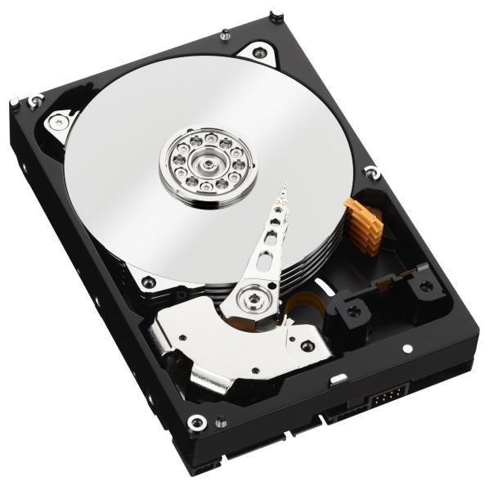
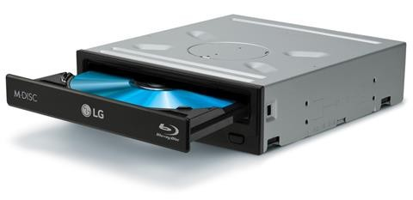
Select PC Components (Cont.)
Select Hard Drives
  Important hard drive factors to be considered are speed, storage space and communication interface type.
  The drive’s underlying technology (HDD vs SSD) directly
impacts speed.
Select a Media Reader
  The media reader must be compatible with customer media.
Select Optical Drives
  Make sure the drive is compatible with customer media.
  Other factors to consider are speed, communication interface type and the ability to write to the media.

Slide 17
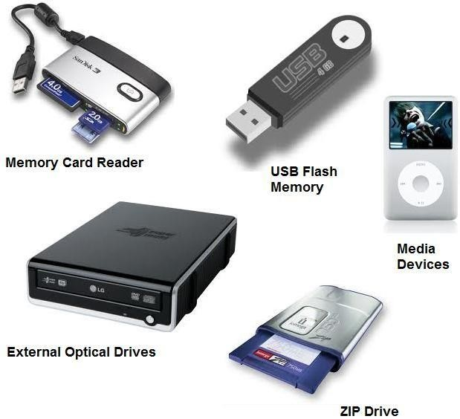
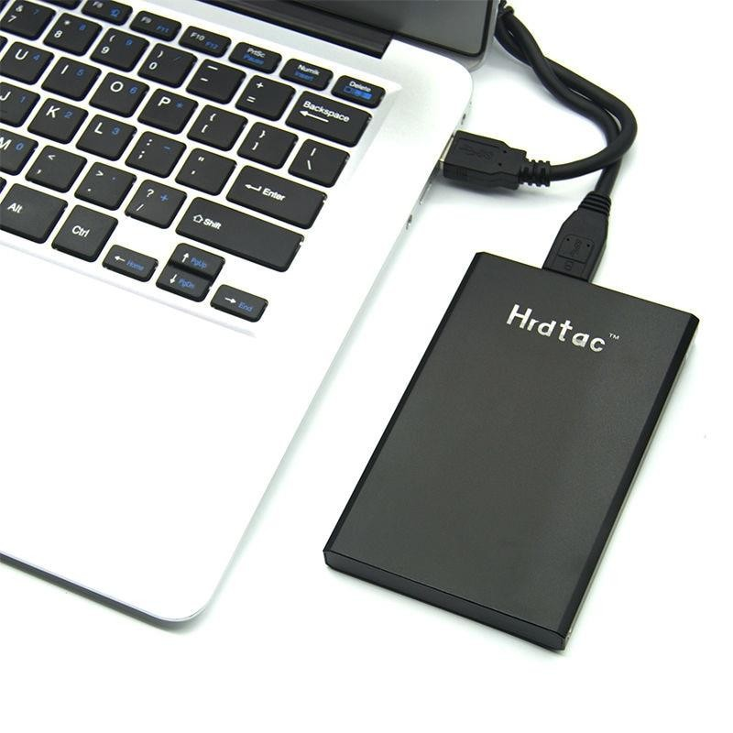
Select PC Components (Cont.)
Select External Storage
  Important factors when selecting external storage are storage space, speed and communication interface.
  Make sure the computer has enough ports to accommodate the external devices and peripherals.
Select I/O Devices
  The selection of I/O devices is application specific and
will depend on customer requirements.
  Make sure the computer has enough communication ports and that they are compatible with the types required by the I/O devices.

Slide 18
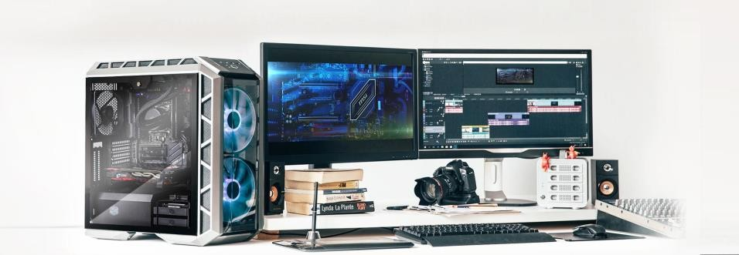
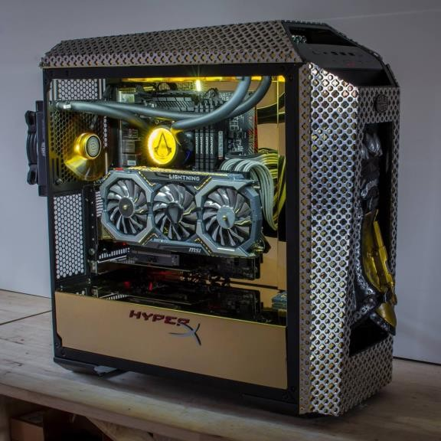
Specialized Computer Systems
Thick and Thin Clients
  Thin clients have little processing power and are designed
to act as a terminal to a server (thick client).
  Thick clients have more powerful CPUs, more memory and their own storage. They serve as processing stations for thin clients.
CAx Workstations
  Designed to support CAD and CAM applications.
  Plenty of RAM, fast disks, powerful CPU and special input devices are common resources.
Audio and Video Editing Workstations
  Common editing workstation resources include much RAM, fast disks, powerful CPU and special adapter cards such as audio and video capture.

Slide 19
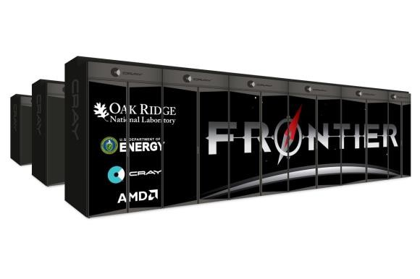
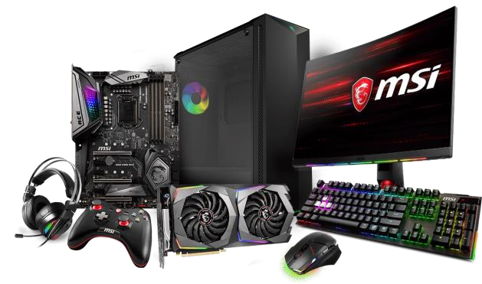
Specialized Computer Systems (Cont.)
Virtualization Workstations
  These workstations are designed to run virtual computers
  Virtual computers use and share the workstation’s physical resources such as CPU, memory and disks.
  The selection of physical resources will depend on the number and purpose
of the virtual machines.
Gaming PCs
  Due to high resource requirements of modern games, gaming PCs are very resource demanding.
  A few requirements of gaming PCs are: top end CPU, lots of fast RAM, fast disks, high performance input devices and audio systems.
Home Theatre PCs
  These computers must be able to play various media formats and, in some cases, receive TV signals.
  Common HTPC requirements include powerful CPU, fast RAM, large disks, fast NIC and video card with TV input.

